Slide 1
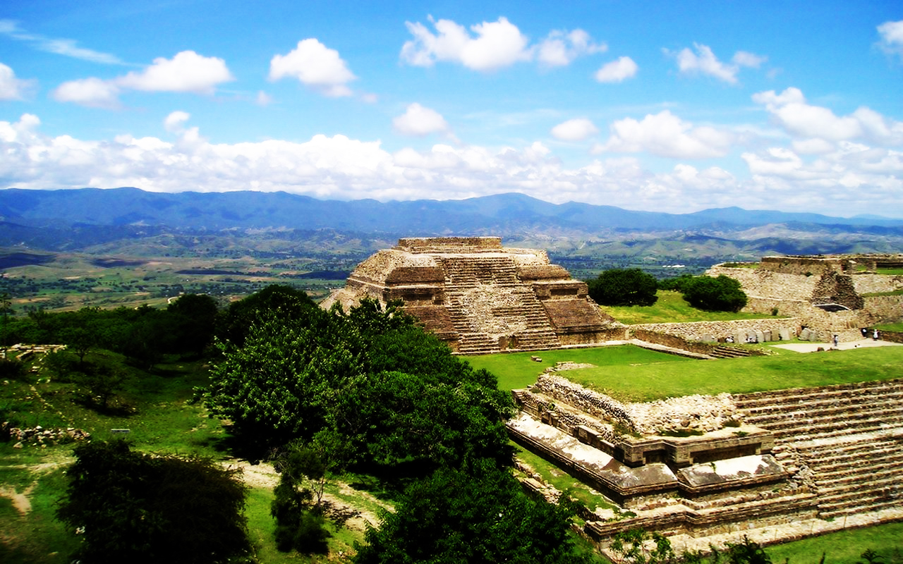
Monte Albán
“the Capital of the zapotecs”
http://blogvoyages.fr/oaxaca/

Slide 2
Location: Oaxaca, Mexico
http://oaxacaviablogspot.blogspot.com/
Notes:
Oaxaca is located in the southeastern are of Mexico. 285 miles from Mexico City.

Slide 3
http://www.latinamericanstudies.org/zapotecs.htm
Notes:
Diego Rivera Mural – The Zapotecs

Slide 4
The Zapotecs: “The People”
500 BCE: The city of Monte Albán was founded
After 650 B.C. Monte Albán was the most powerful cities of Mexico.
Developed a calendar→260 days → piye
Writing system: used separate glyphs to represent each of the syllables of the language
Believed to have been the first writing system of Mesoamerica → Maya, Mixtec, and Aztec
900 CE: The city lost power and it was abandoned

Slide 5
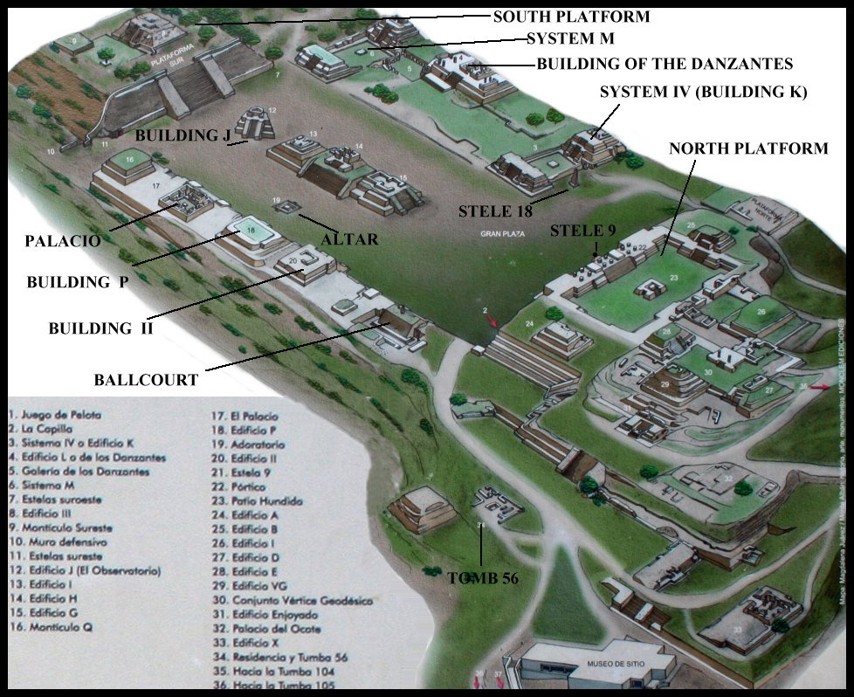
Important Constructions:
The Palace
Ball Court
The Danzantes
Tomb 7
http://www.bluffton.edu/~sullivanm/mexico/oaxaca/montealban/maprevised.jpg

Slide 6
The Palace:
http://www.minube.com/fotos/rincon/2170801/7482264

Slide 7
http://www.minube.com/fotos/rincon/2170801/7482266

Slide 8
Ball Court
http://www.monte-alban.com/ballgame.htm

Slide 9
The Danzantes
https://geolocation.ws/v/P/73214168/gallery-of-los-danzantes-monte-albn/en

Slide 10
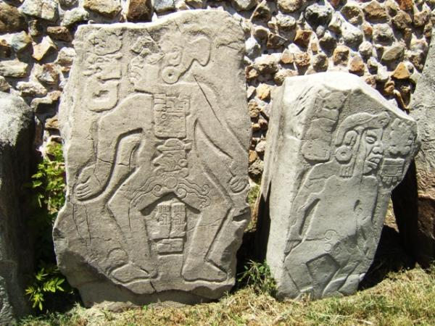
Danzantes
http://difusionmaya.blogspot.com/2010/07/los-danzantes-de-monte-alban.html
http://www.monte-alban.com/danzantes.htm

Slide 11
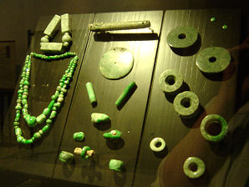
Tomb 7
http://delange.org/MonteAlban5/MonteAlban5.htm
http://delange.org/MonteAlban5/MonteAlban5.htm

Slide 12
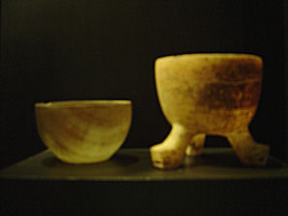
Carved Stone Cups
http://delange.org/MonteAlban5/MonteAlban5.htm
http://delange.org/MonteAlban5/MonteAlban5.htm

Slide 13
Works Cited
“Monte Albán- Archeological Zones.” Mexonline. Web. 25 February 2015. http://www.minube.com/fotos/rincon/2170801/7482264
“The Zapotecs.” Mexican History.Web. 25 February 2015. http://mexicanhistory.org/zapotec.htm
Schmal, John P. “The Mixtec and Zapotecs :Two enduring cultures of Oaxaca.” History of Mexico. Houston Institute for Culture. Web. 25 February 2015. http://www.houstonculture.org/mexico/oaxaca_cultures.html

